Slide 1
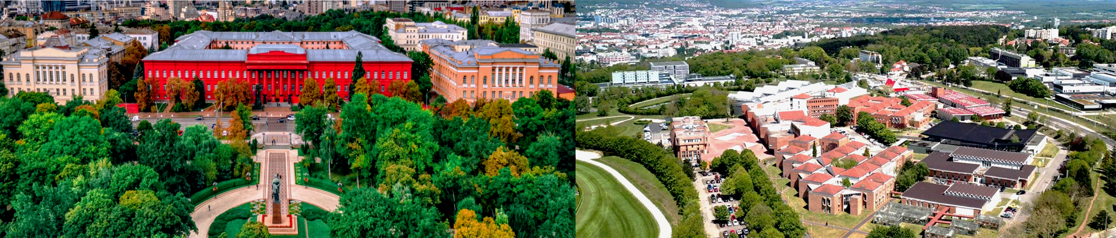
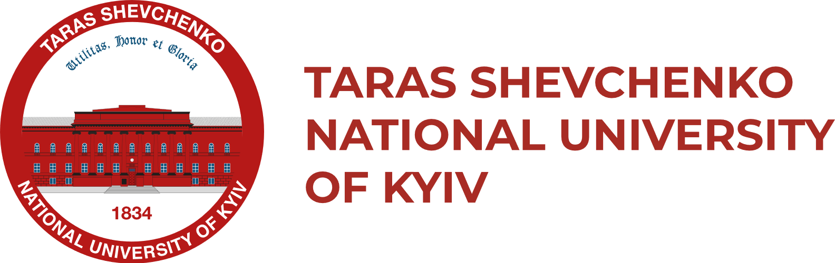

International partnerships
PHYSICS FACULTY

Slide 2

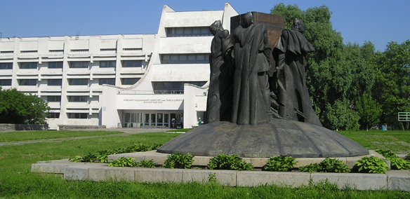


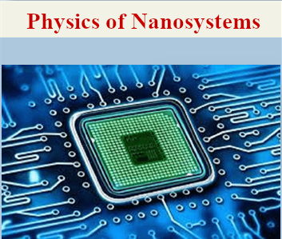
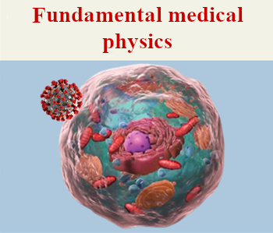
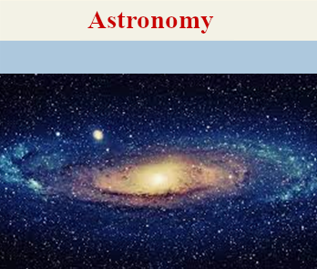
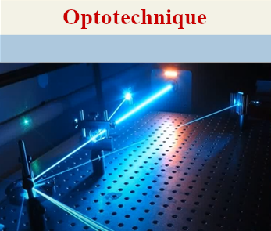
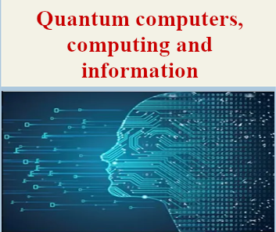
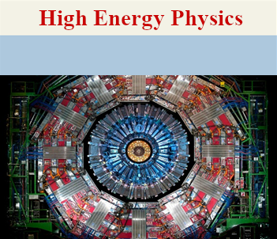
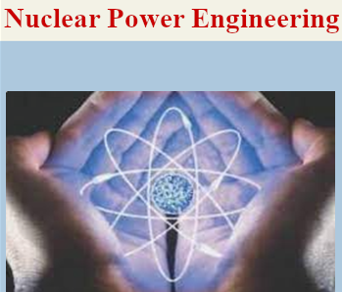
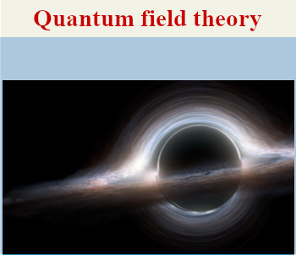
500 students
80 lecturers
140 researchers

Slide 3
EDUCATION
Master’s program “Physics of Nanosystems”
Selected courses:
Nanoelectronics
Physical properties of nanosystems
Theory and modelling of nanostructures
Physics of semiconductor heterostructures
Theory of nanocomposites
Physics of carbon nanocomposites
Modern problems in physics of nanosystems
Opportunities for students:
Various types of educational internships
Laboratory work
Participation in research projects
Academic mobility

Slide 4
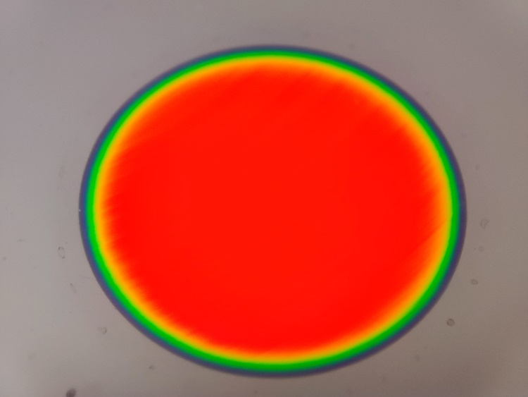
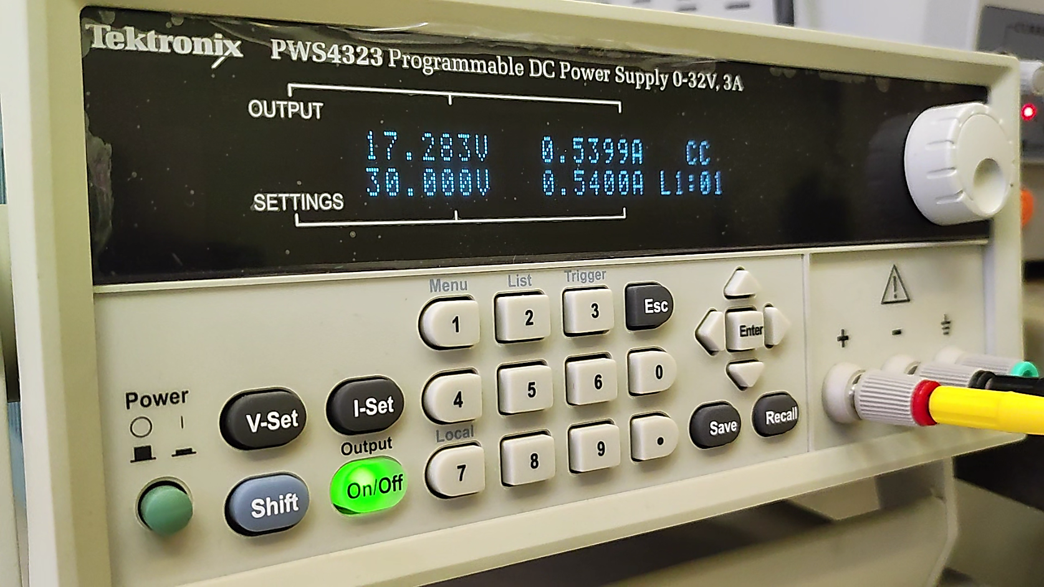
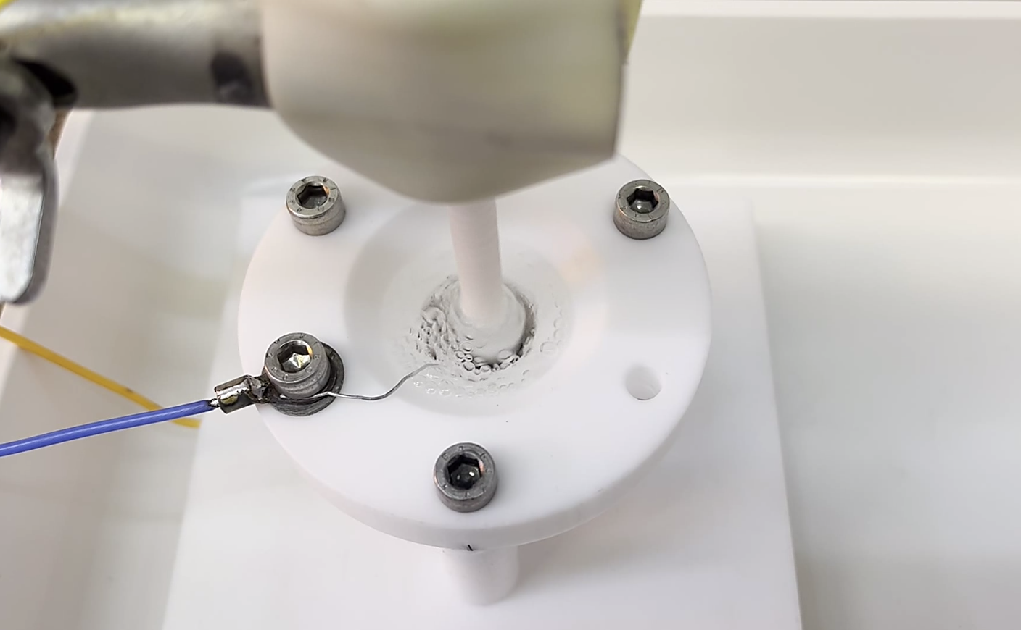
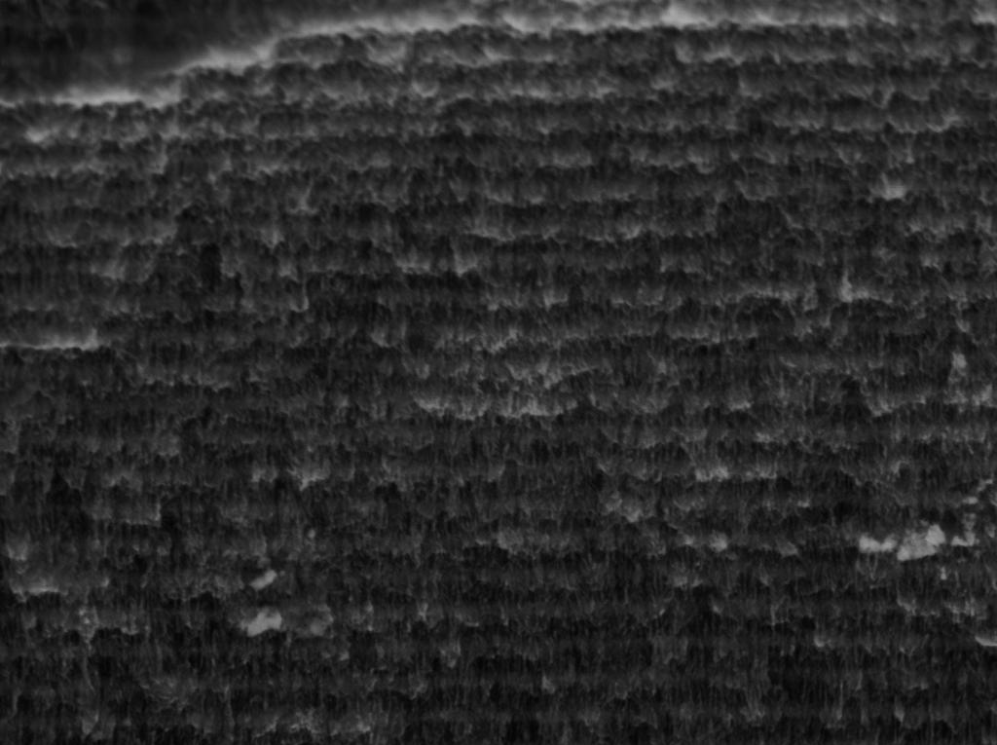
JOINT SCIENTIFIC RESEARCH
1. Synthesis of silicon multilayer porous structures and investigation of their structure, optical, and thermal properties
Electro-chemical etching of multilayer porous silicon
Gravimetry, Optical and scanning electron microscopy
Spectroscopic optical techniques

Slide 5
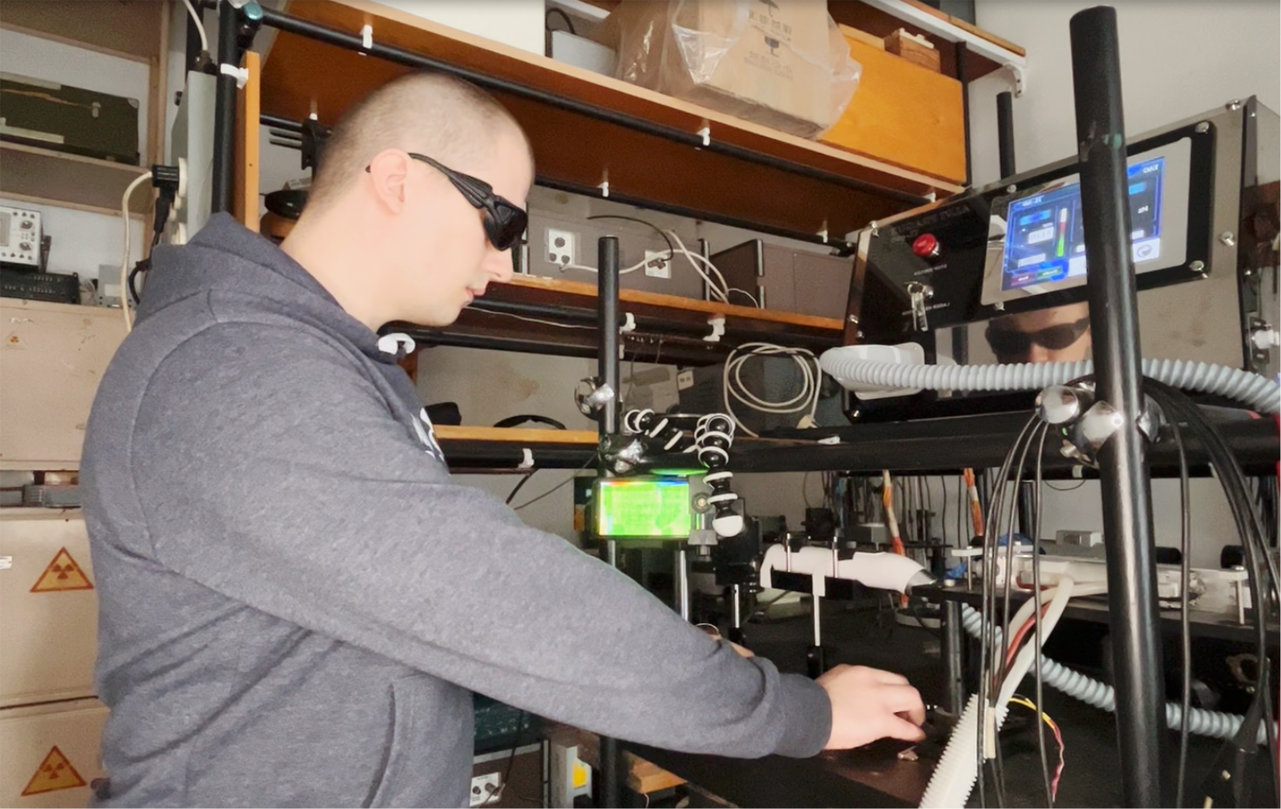
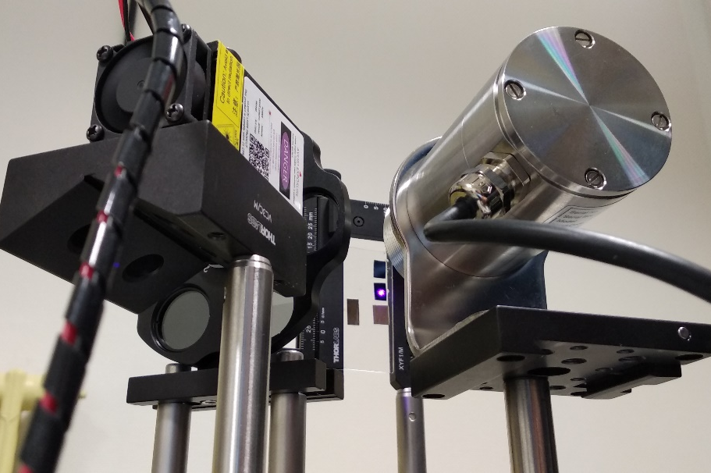
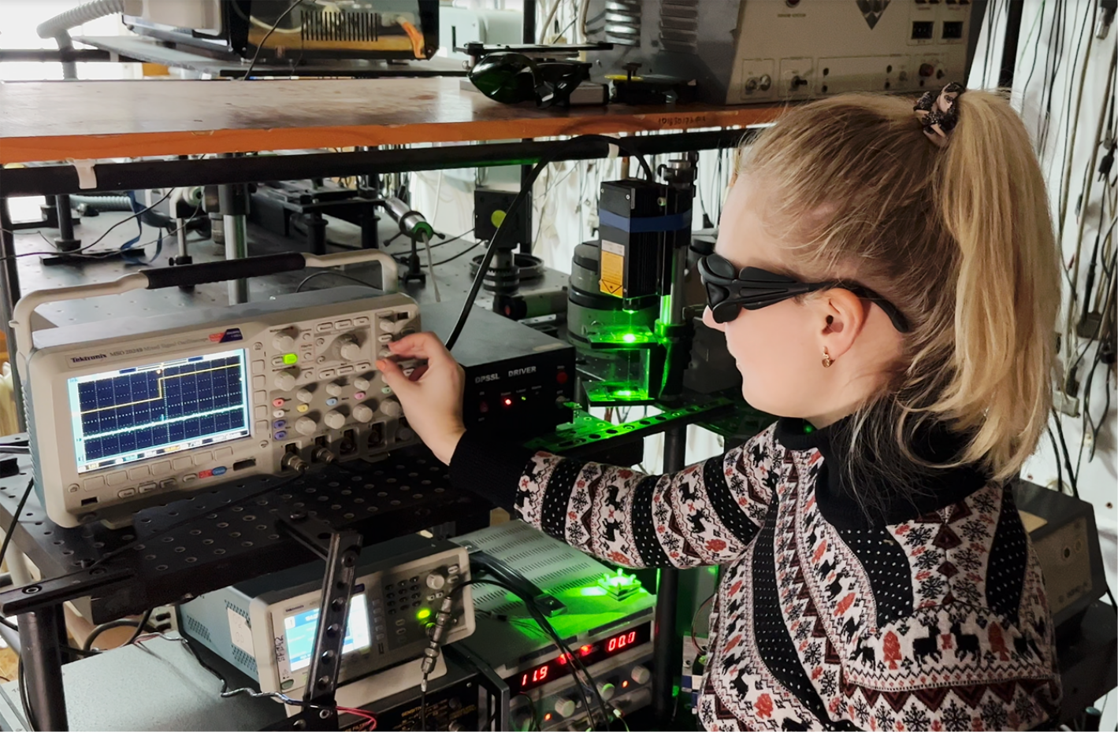
JOINT SCIENTIFIC RESEARCH
1. Synthesis of silicon multilayer porous structures and investigation of their structure, optical, and thermal properties
Photoacoustic and Photothermal techniques :
- with laser irradiation in steady-state, transient, and modulation modes
- gas-microphone, piezoelectric signal detection, and direct temperature measurements

Slide 6
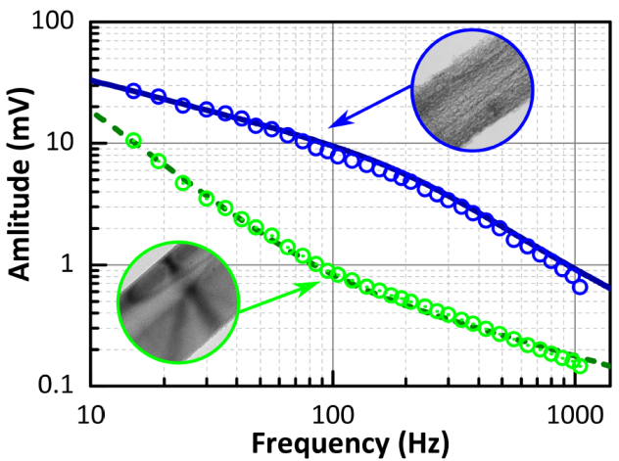
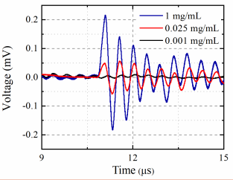
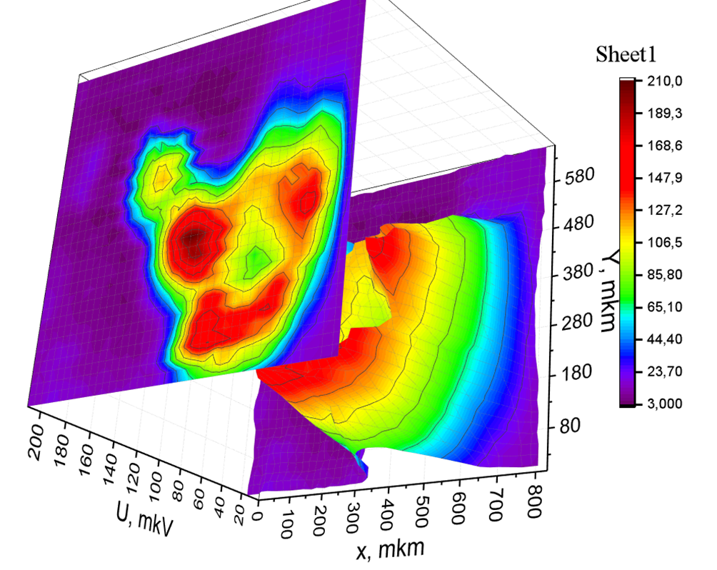
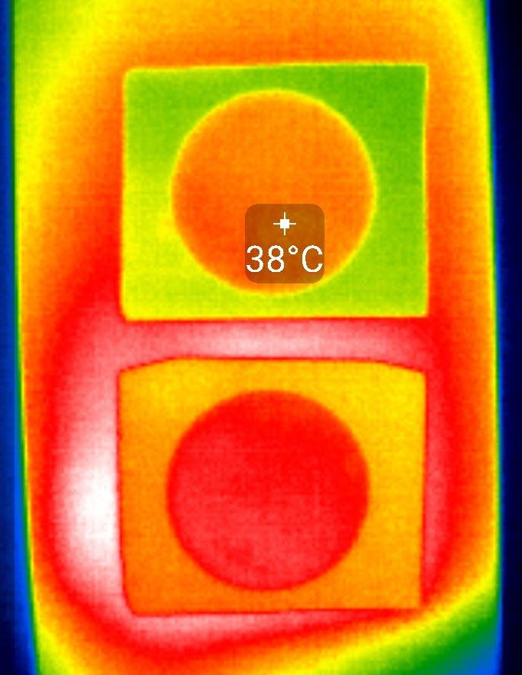
JOINT SCIENTIFIC RESEARCH
1. Synthesis of silicon multilayer porous structures and investigation of their structure, optical, and thermal properties
The outcomes achievable through Photoacoustic and Photothermal techniques :
amplitude-frequency and phase-frequency responses
time and temperature dependent response of informative signal
photoacoustic and photothermal imaging
thermal diffusivity and thermal conductivity parameters

Slide 7
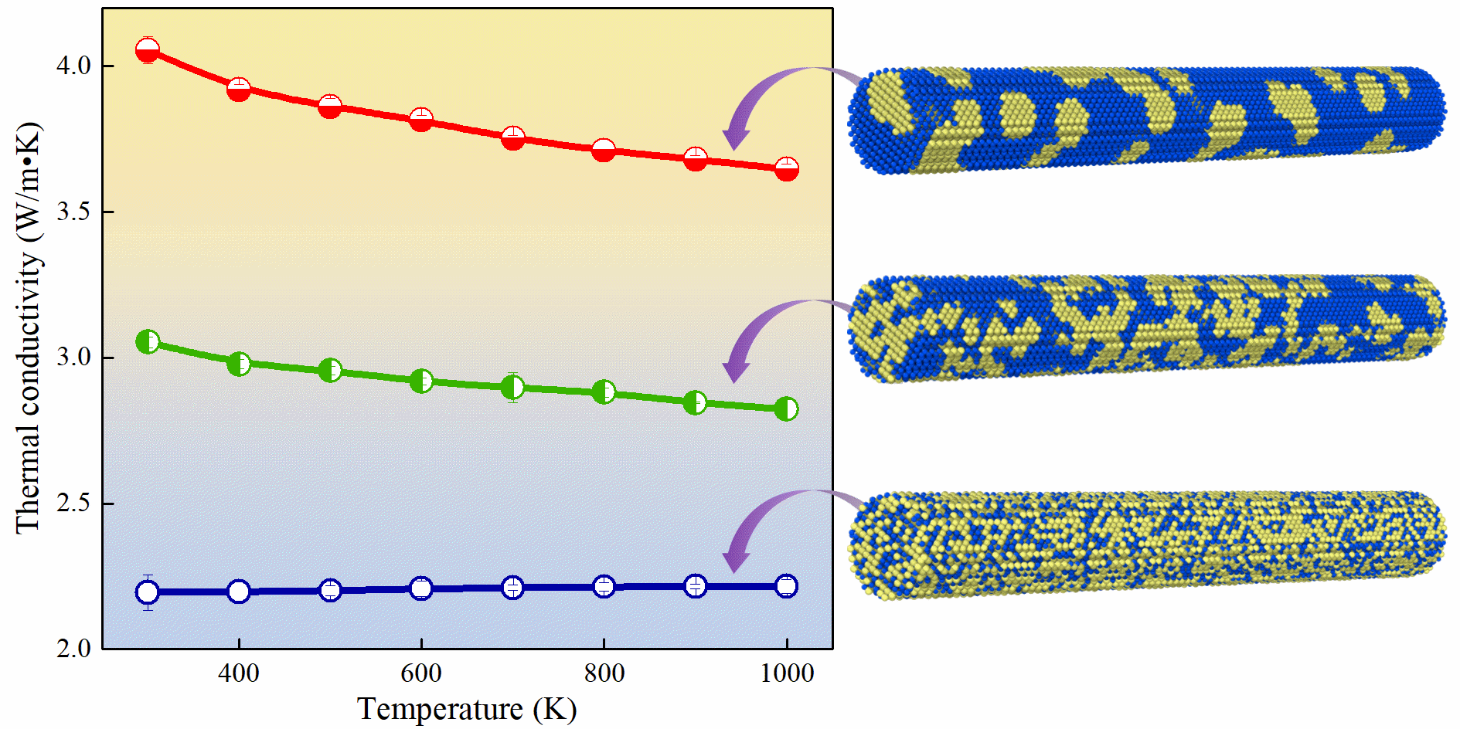
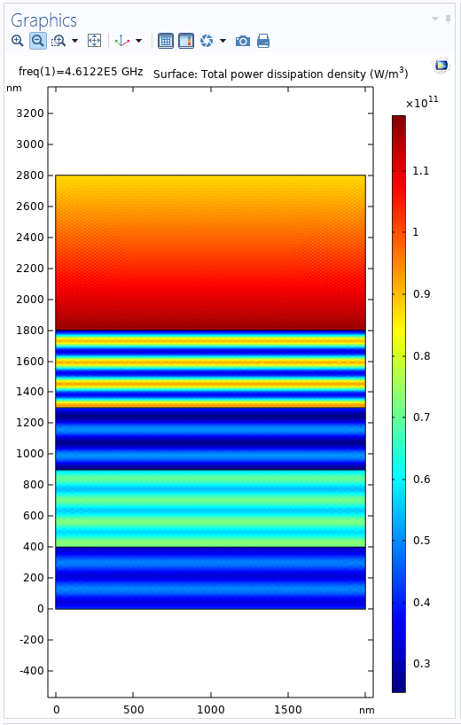
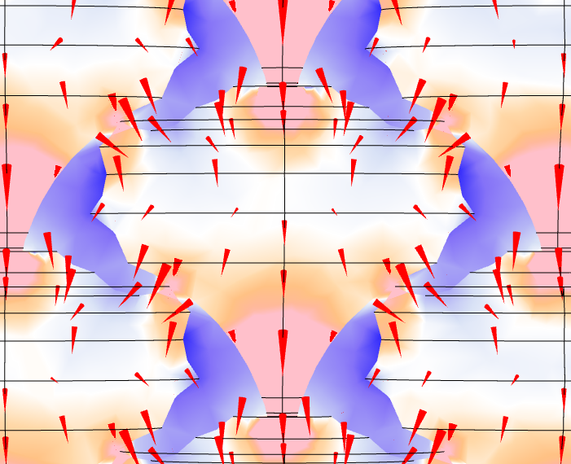
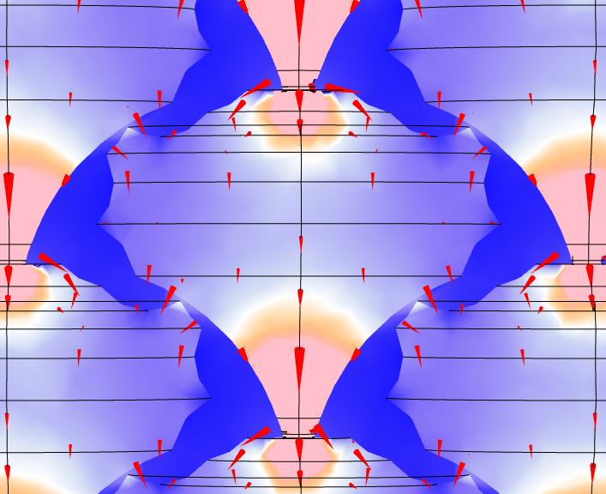
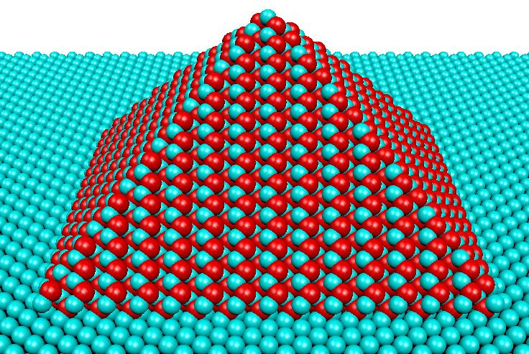
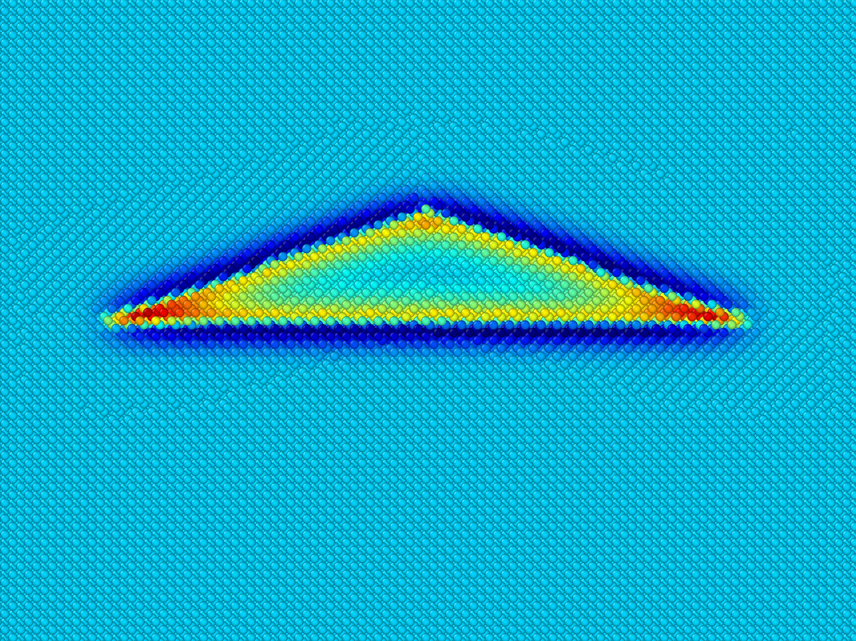
JOINT SCIENTIFIC RESEARCH
2. Modeling of phonon transport properties of nanostructures for thermal management and thermoelectric applications
Molecular dynamics simulation of thermal conductivity of semiconductor nanostructures
Anharmonic lattice dynamics
Analytical modeling of phonon transport in nanostructures
Finite element modeling of thermal phenomena in materials

Slide 8
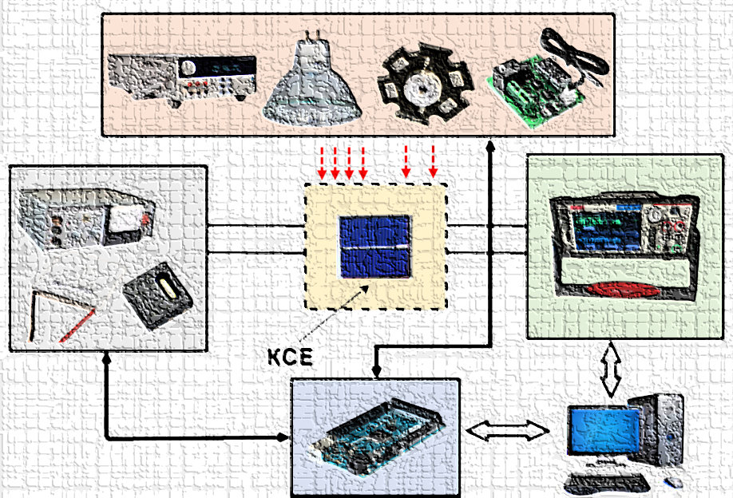
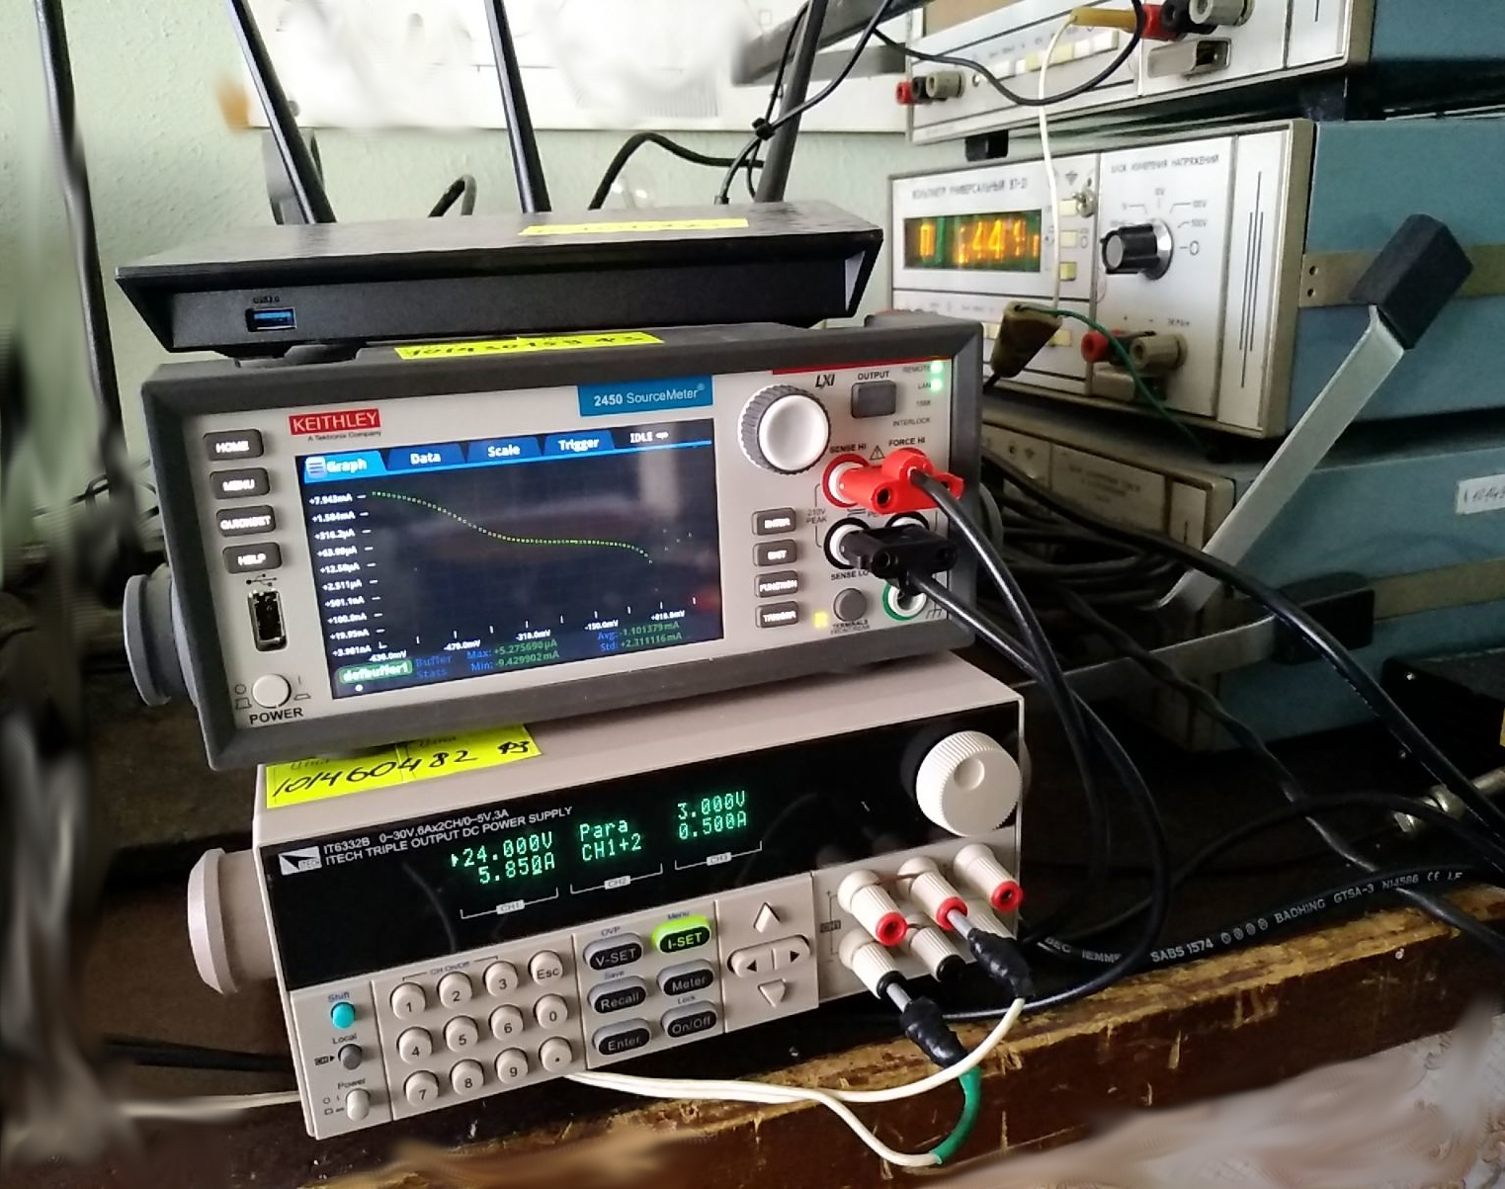
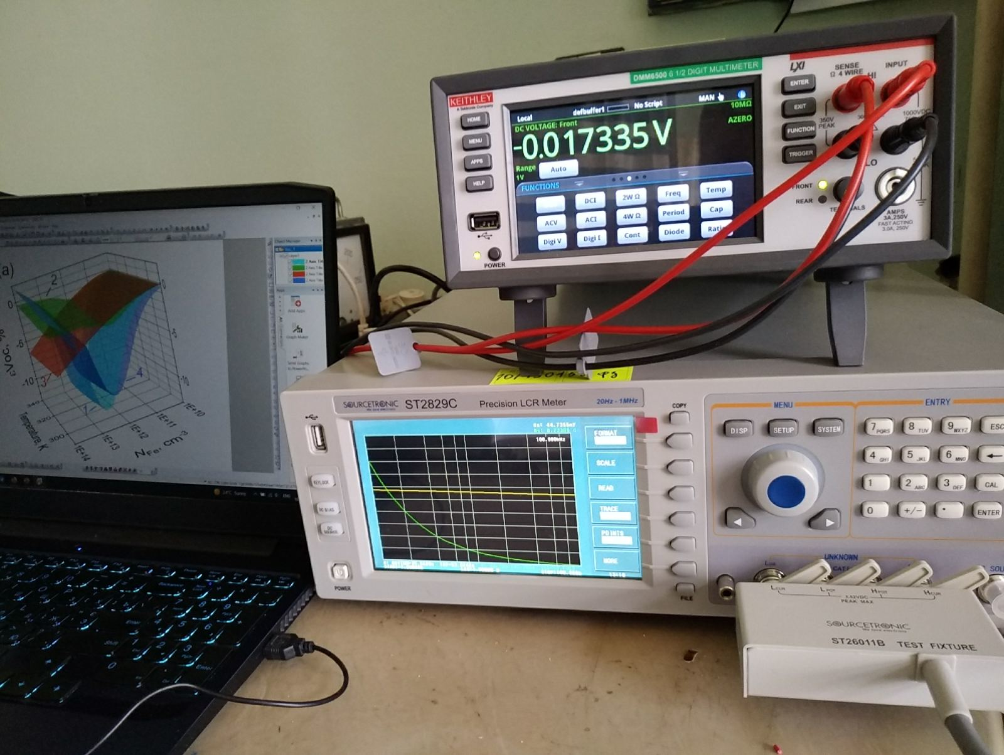
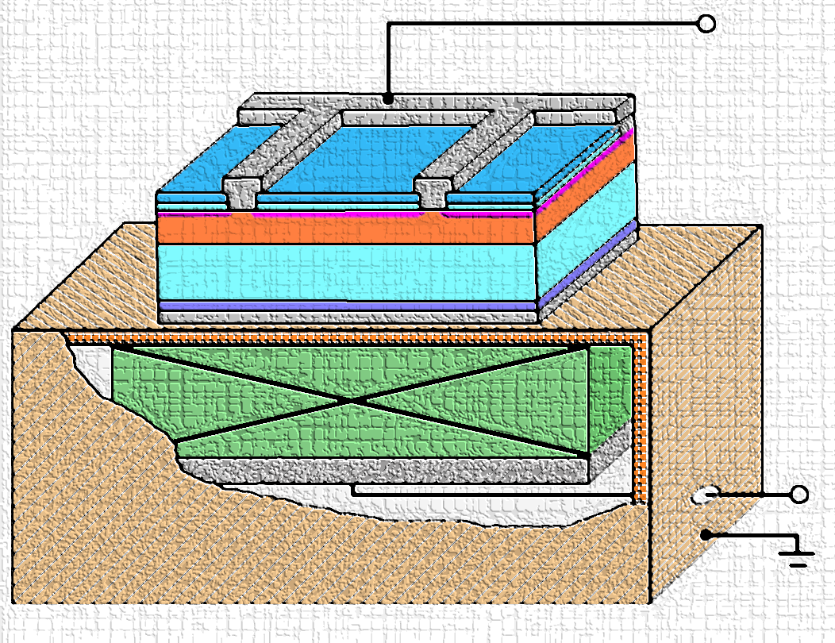
JOINT SCIENTIFIC RESEARCH
3. Experimental investigations of semiconductor structures for thermoelectrics and solar cells
Current-voltage measurement of solar cells (20 mV – 200 V, 10 nA – 1 A, 150 – 350 K)
Capacitance-voltage measurements of semiconductor barrier structures (20 Hz – 1MHz, 1fF – 10 F, 5mV – 10 V)
Determination of semiconductor structures’ parameters under ultrasound action (100 kHz – 30 MHz, transverse and longitudinal waves)

Slide 9
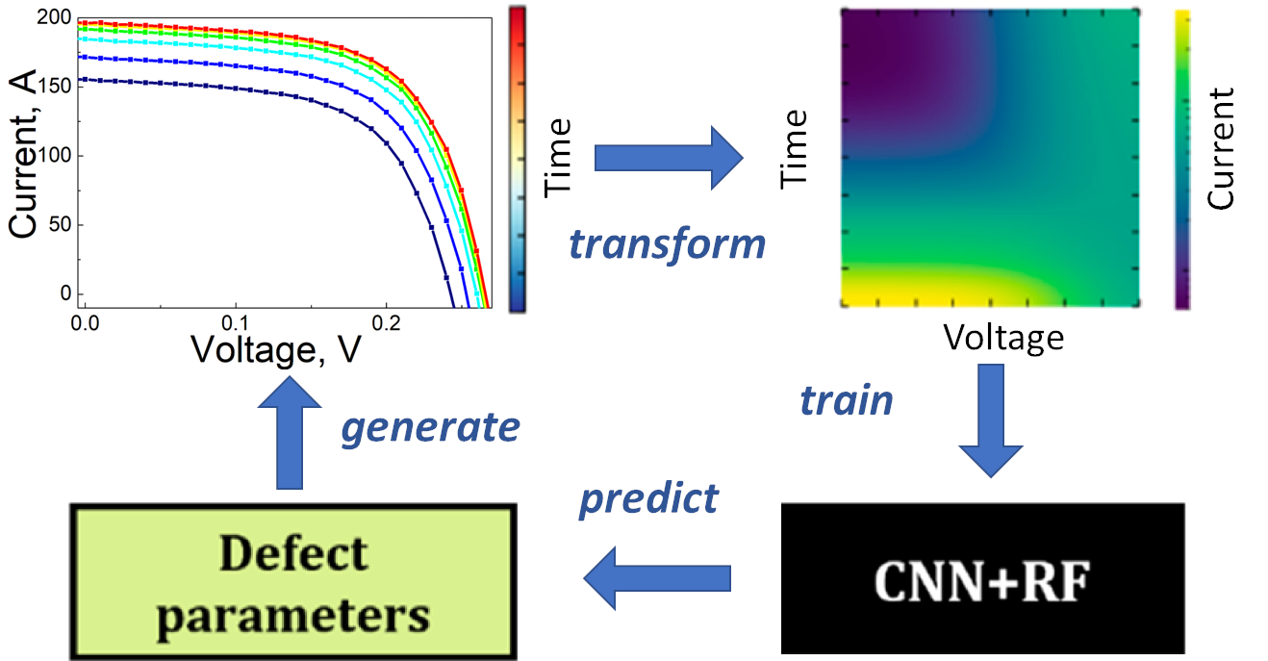
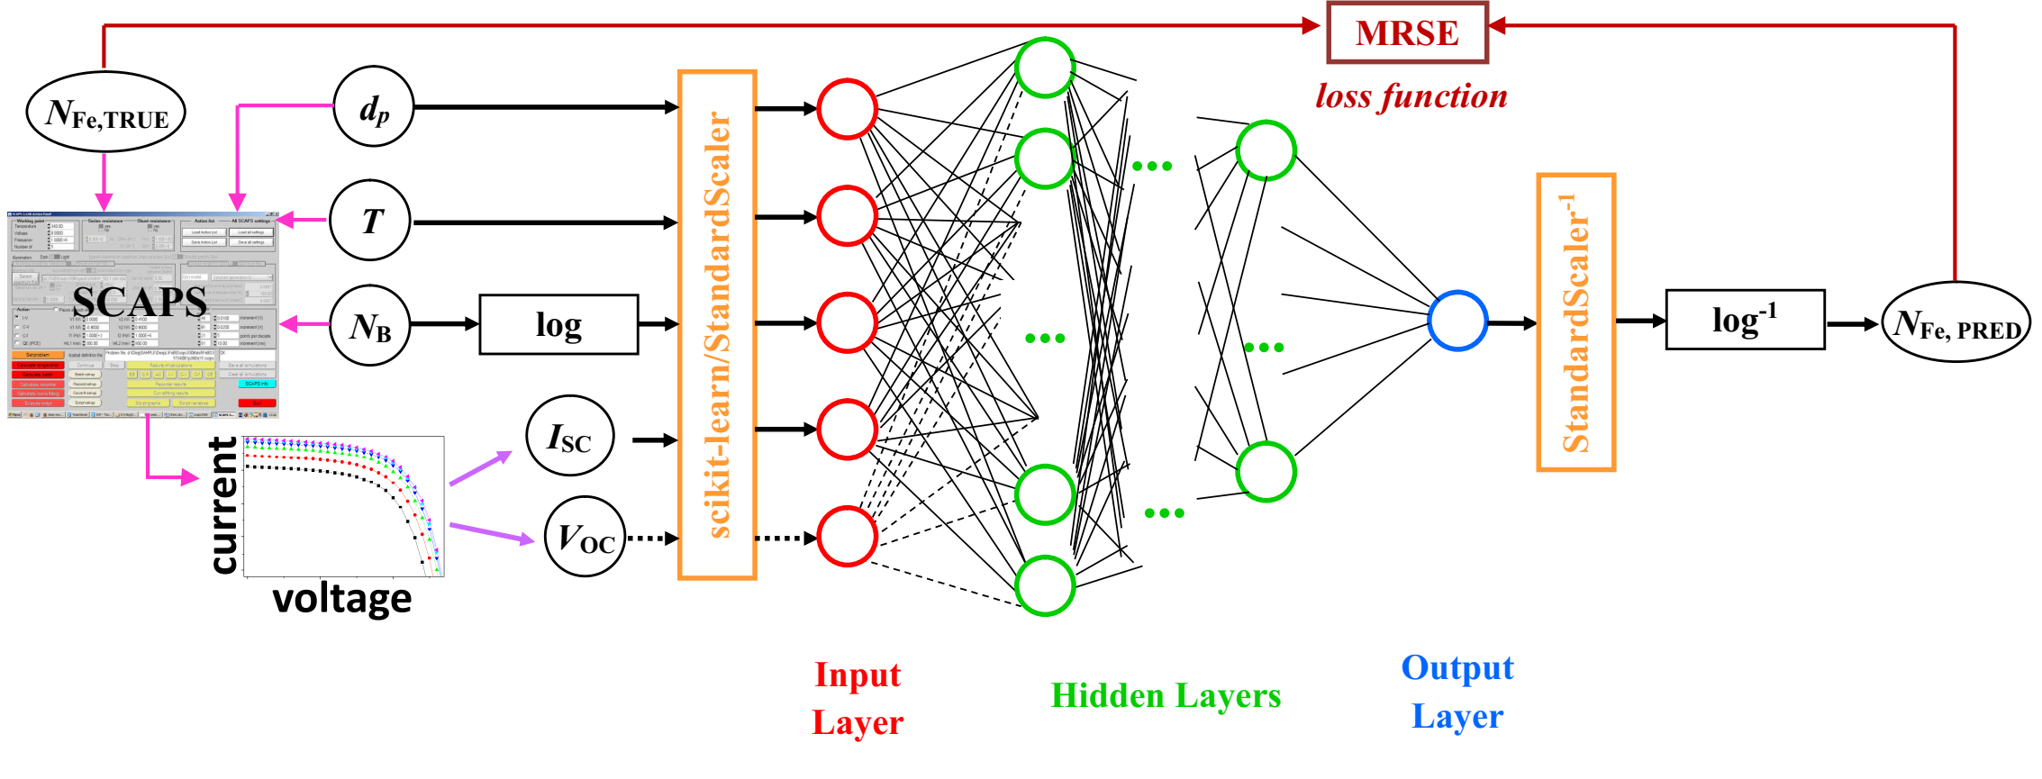
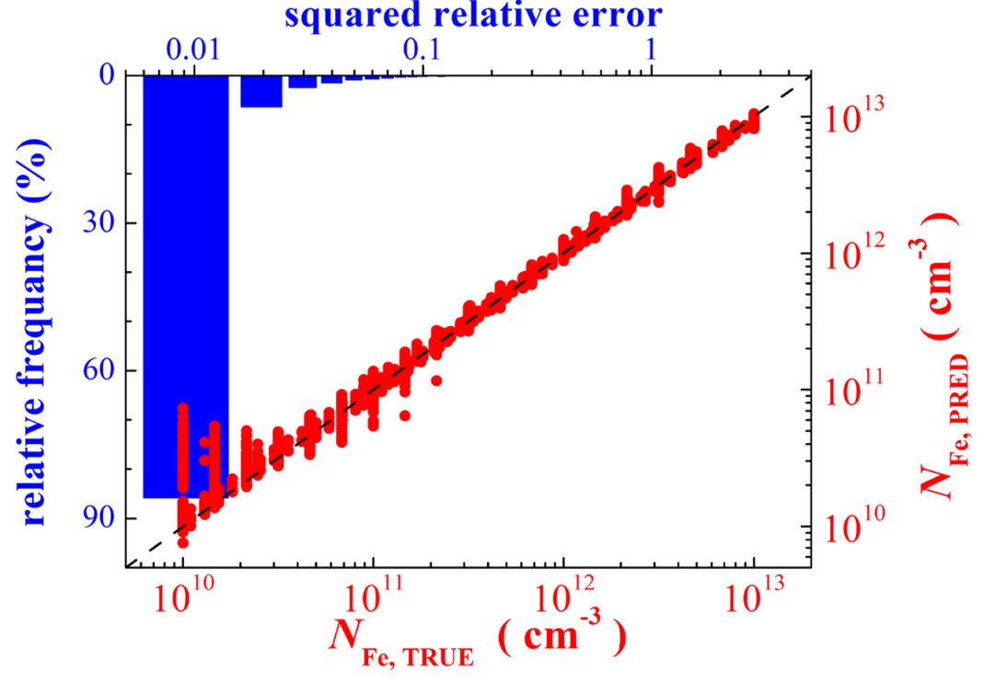
JOINT SCIENTIFIC RESEARCH
4. Using machine learning for estimation of defect contamination in solar cells
Simulation of photovoltaic structures for labeled dataset preparation
Exploring, teaching, and tunning machine learning algorithms
Testing of developed models on actual silicon solar cells

Slide 10
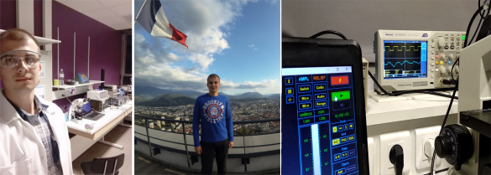
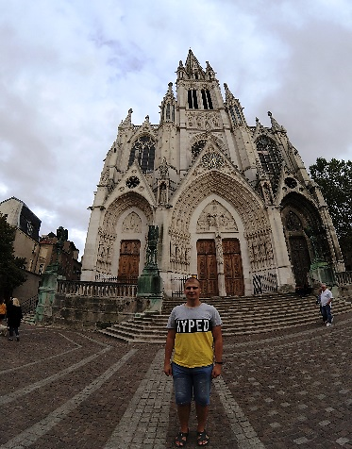
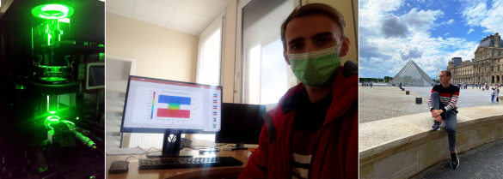
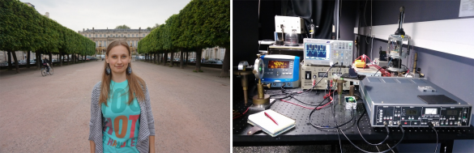
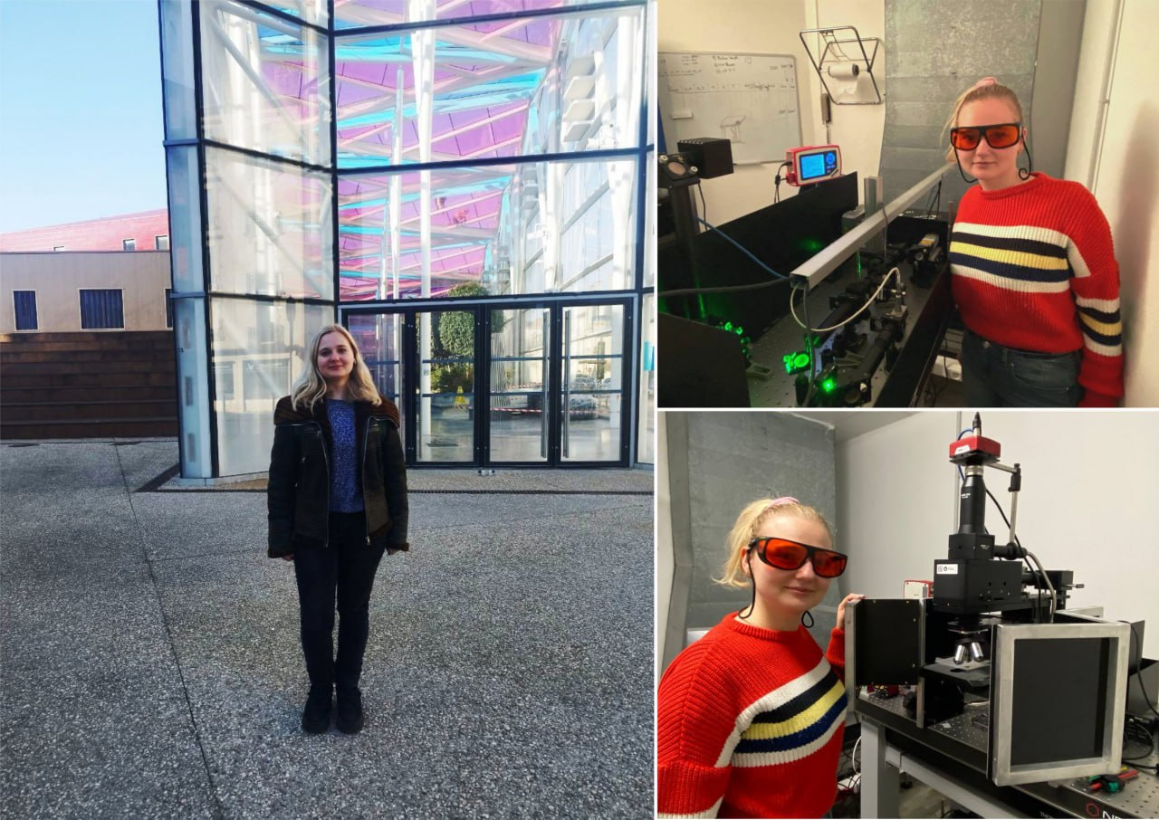
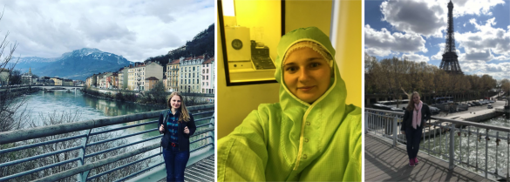
EXCHANGE OF SCIENTIFIC EXPERIENCE
PAVLO LISHCHUK: joint experimental research on thermal transport in semiconductor structures (2017-2019).
VIKTOR MANDROLKO during academic mobility within the Erasmus+ program (2021-2022)
KATERYNA DUBYK: experimental research on colloidal solutions of nanoparticles with varying content of carbon materials (2016, 2017).
LESIA CHEPELA during academic mobility within the Erasmus+ program (2019, 2023).

Slide 11
JOINT SCIENTIFIC PUBLICATIONS
Thermal transport properties of nanoporous silicon with significant specific surface area. Mykola Isaiev; Yuliia Mankovska; Vasyl Kuryliuk; David Lacroix. Appl. Phys. Lett. 2023, 122, 172201
Investigation of Thermal Transport Properties of Multilayer Porous Silicon Based Hybrid Nanostructures by Photoacoustic Technique. Pavlo Lishchuk; Lesia Chepela; Vasyl Kuryliuk; Elysaveta Polishchuk; Viktoria Shevchenko; Mykola Borovyi; David Lacroix; Mykola Isaiev. Proceedings of the 2022 IEEE 12th International Conference "Nanomaterials: Applications and Properties", NAP 2022, 2022
Fabrication and Photoacoustic Characterization of Multilayered Structures Based on Porous Silicon. Lesia Chepela; Pavlo Lishchuk; Viktoria Shevchenko; Vasyl Kuryliuk; Elysaveta Polishchuk; Andrey Kuzmich; Petro Teselko; Igor Matushko; Mykola Borovyi. 2022 IEEE 41st International Conference on Electronics and Nanotechnology, ELNANO 2022 - Proceedings, 2022, pp. 178–181
Melting Threshold and Thermal Conductivity of CdTe Under Pulsed Laser Irradiation. V. P. Veleschuk, V. A. Gnatyuk, T. Aoki, Z. K. Vlasenko, S. N. Levytskyi, A. V. Shefer, A. G. Kuzmich, K. V. Dubyk, V. V. Kuryliuk & M. V. Isaiev. Lecture Notes in Networks and Systems, 2020, 101, pp. 101–109
Impact of thermal annealing on photoacoustic response and heat transport in porous silicon based nanostructured materials. Pavlo Lishchuk; Ali Belarouci; Roman Tkach; Kateryna Dubyk; Roman Ostapenko; Vasyl Kuryliuk; Guillaume Castanet; Svitlana Naumenko; Andrey Kuzmich; Fabrice Lemoine; Vladimir Lysenko; David Lacroix; Mykola Isaiev. AIP Conference Proceedings, 2019, 2170, 020008
Thermal conductivity of strained silicon: Molecular dynamics insight and kinetic theory approach. Vasyl Kuryliuk; Oleksii Nepochatyi; Patrice Chantrenne; David Lacroix; Mykola Isaiev. Journal of Applied Physics, 2019, 126(5), 055109

